Slide 1
SEVEN TESTING PRINCIPLES
TEAM 1

Slide 2


1
TESTING SHOWS THE PRESENCE OF DEFECTS, NOT THEIR ABSENCE

Slide 3

2
EXHAUSTIVE TESTING IS IMPOSSIBLE

Slide 4

3
EARLY TESTING SAVES TIME AND MONEY

Slide 5

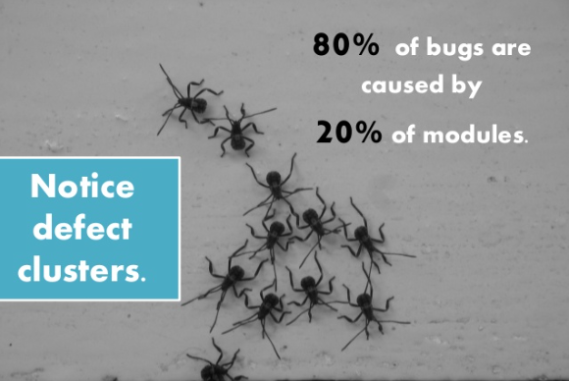
4
DEFECTS CLUSTER TOGETHER

Slide 6
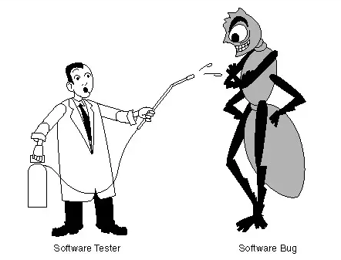

5
BEWARE OF THE PESTICIDE PARADOX

Slide 7

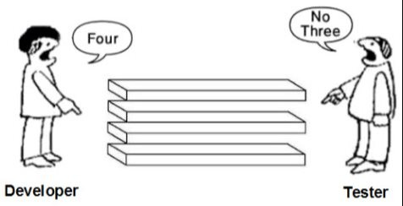
6
TESTING IS CONTEXT-DEPENDENT

Slide 8

7
ABSENCE-OF-ERRORS IS A FALLACY

Slide 9
THE END
THANK YOU FOR LISTENING

